Slide 1
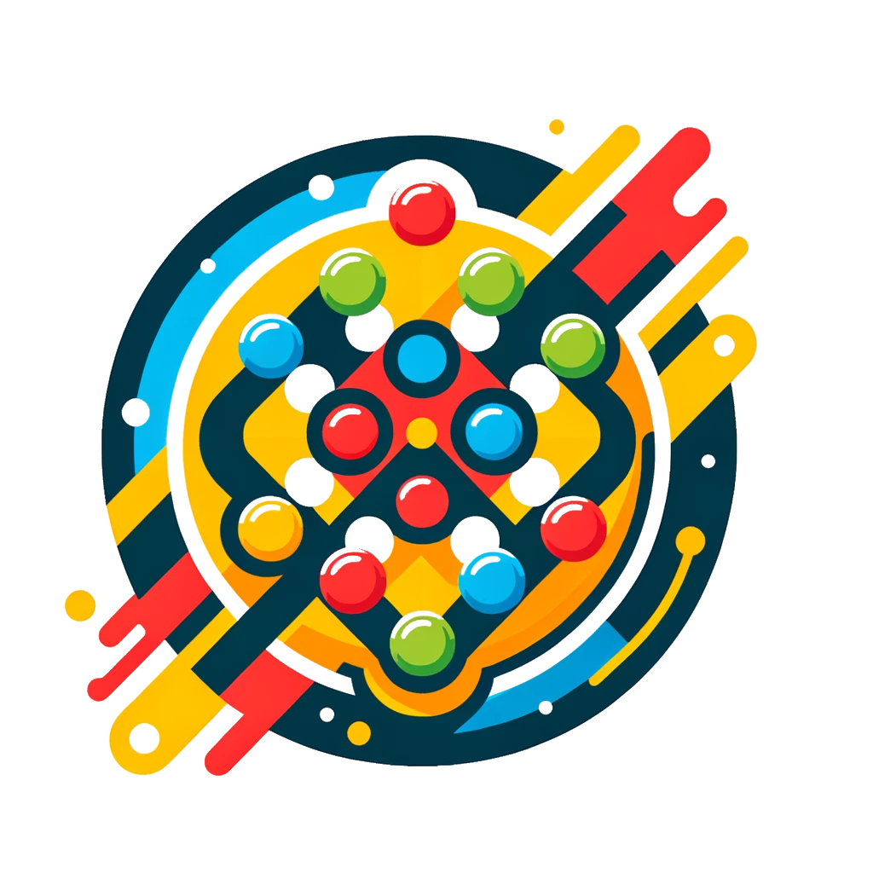
Connect4
Rustam Rahimov - 211ADB058
Pavlo Nikolaiev - 201ADB090
Mert Gulmus - 211ADB070

Slide 2
Chosen game
We decided to create a Connect 4 game using a web framework.
Connect 4 is a two player game, usually played on 6x7 board. Each player places a circle into the bottom of the board or on top of a circle placed before one. The main win condition it to form a line out of 4 circles either horizontally, vertically or diagonally.

Slide 3
Requirement additions
The main additions implied in the app are the following:
The game is playable by two players on the same device.
The user interface should be intuitive and easy to navigate.
The game board should dynamically update to show the current state of play.
The game should detect a win condition and display a message to the players.
The game should offer a way to reset and start a new game.
The user can log in with a username.
The user should see their game history if they are logged in.

Slide 4
Design
We decided that creating a simplistic, modern UI would ensure a balance between functionality and aesthetics.
Using simplistic UI design also allow us to integrate responsive design and work on multiple devices, such as desktop and mobile.

Slide 5
Implementation
Chosen language & framework: JavaScript & ReactJS
Approach: Mixed, both procedural and object-oriented
Version control: Github (Git)
Platform: Web-based

Slide 6
Testing
It is essential to test the program to understand the effectiveness of the program, whether the program makes correct decision upon the given inputs
We utilized Jest framework to perform out tests, since it has extensive React support.
In our case the tests taken for the program check the following aspects of the program:
User interface tests: testing the responsiveness of the game UI design
Game decision tests: testing the decision the game is going to make based on the state of the game
Game history tests: testing what is going to be saved in history after each game

Slide 7
Demonstration

Slide 8
Conclusions
The main lessons that our team learned are:
Working with ReactJS and creating single-page web apps
Designing the game and creating UI
Teamwork and even separation of the workflow
How to develop a software and steps needed for correct implementation
Utilizing tests using Jest framework
Correctly documenting and reporting the progress made over time

Slide 9
Thanks for your attention! :)

